Slide 1

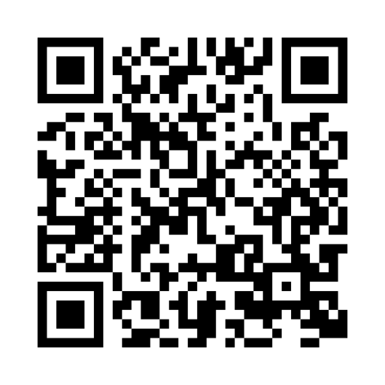

Join a live webinar with Fidelity
Choose from over 300 events a year packed with
  financial tips
  real-life scenarios
  hands-on resources
91%
of webinar attendees
feel confident
in what to do next*
Scan this code to learn more and view upcoming events
Fidelity.com/FidelityLiveWebinars

